Slide 1
Chris Woodruff
EF CORE
TURBO CHARGING FOR PERFORMANCE

Slide 2

Chris Woodruff
linkedin.com/in/chriswoodruff/
https://twitter.com/cwoodruff
https://woodruff.dev
cwoodruff@live.com

Slide 3




Looking at EF Core for Perf
Agenda
Looking at .NET for Perf
Questions & Answers

Slide 4
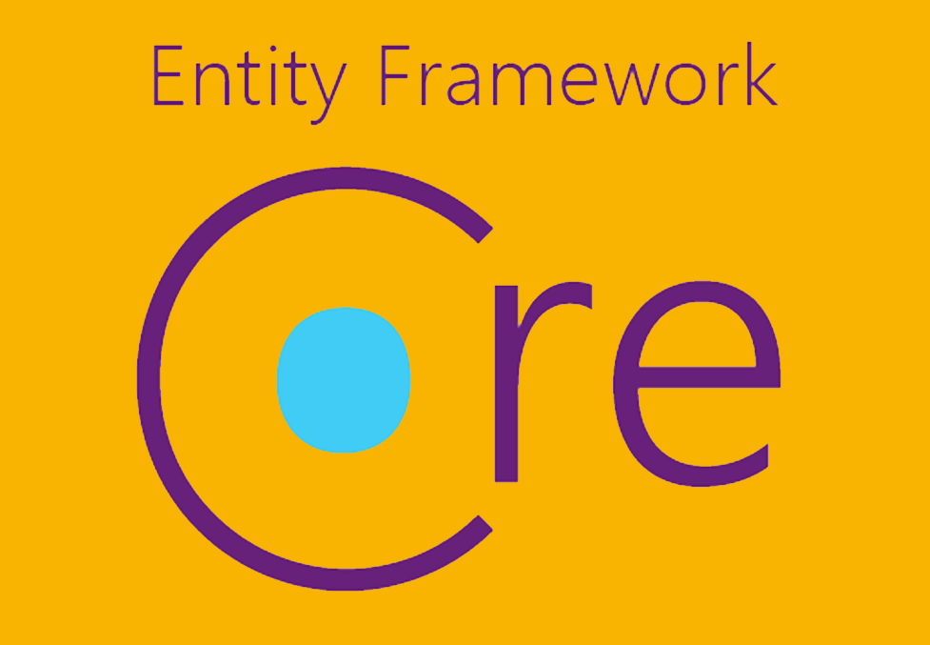
EF CORE

Slide 5






WHAT IS ENTITY FRAMEWORK CORE?
Where did it come from?
100% OPEN SOURCE
CROSS-PLATFORM
PERFORMANCE

Slide 6
DBCONTEXT POOLING
DI Container
public class BlogsController : Controller
{
private BlogContext _context;
public BlogsController(BlogContext context)
{
_context = context;
}
public IActionResult Index()
{
return _context.Blogs.ToList();
}
}
Request: /blogs/index
Scope
BlogContext
Blogs
Controller
Request: /blogs/index
Scope
BlogContext
Blogs
Controller
Request: /blogs/index
Scope
BlogContext
Blogs
Controller

Slide 7
DBCONTEXT POOLING
DI Container
public class BlogsController : Controller
{
private BlogContext _context;
public BlogsController(BlogContext context)
{
_context = context;
}
public IActionResult Index()
{
return _context.Blogs.ToList();
}
}
Request: /blogs/index
Context Pool
Scope
BlogContext
BlogContext
Scope
Blogs
Controller
BlogContext
BlogContext
BlogContext
Request: /blogs/index
BlogContext
BlogContext
Blogs
Controller
Scope
Request: /blogs/index
Scope
BlogContext
Blogs
Controller

Slide 8
COMPILED QUERIES
var explicitQuery = EF.CompileQuery((ChinookContext context, int id)
=> _context.Albums.FirstOrDefault(a => a.Id == id));
var compiledExplicitQuery =
EF.CompileAsyncQuery((ChinookContext context, int id)
=> context.Albums.FirstOrDefault(a => a.Id == id));

Slide 9
COMPILED MODELS
dotnet ef dbcontext optimize --output-dir ChinookModels --namespace ChinookModels
protected override void OnConfiguring(DbContextOptionsBuilder optionsBuilder)
=> optionsBuilder
.UseModel(ChinookModels.AlbumsContextModel.Instance)
.UseSqServer(“<ConnectionString>");
Things to remember”
Global Query Filters not supported
Lazy-loading and Change-Tracking proxies not supported
You must regenerate the compiled modal each time the code
for the dbcontext changes

Slide 10
FROMSQL
var city = "Redmond";
using (var context = CreateContext())
{
context.Customers.FromSql($@“
SELECT *
FROM Customers
WHERE City = {city}");
}
SELECT *
FROM Customers
WHERE City = @p0
SELECT *
FROM Customers
WHERE City = ‘Redmond’

Slide 11
QUERY PROJECTION
SELECT *
FROM [dbo].[Employee]
SELECT [Id]
,[LastName]
,[FirstName]
,[Title]
,[ReportsTo]
,[BirthDate]
,[HireDate]
,[Address]
,[City]
,[State]
,[Country]
,[PostalCode]
,[Phone]
,[Fax]
,[Email]
FROM [dbo].[Employee]

Slide 12
QUERY PROJECTION
SELECT *
FROM [dbo].[Employee]
SELECT [Id]
,[LastName]
,[FirstName]
,[Title]
,[Address]
,[City]
,[State]
,[Country]
,[PostalCode]
,[Phone]
,[Fax]
,[Email]
FROM [dbo].[Employee]

Slide 13
QUERY PROJECTION
from e in Employees select e
from e in Employees select new { e.Id, e.LastName, e.FirstName, FullName = e.FirstName + " " + e.LastName, e.Title, e.Address, e.City, e.State, e.Country, e.PostalCode, e.Phone, e.Fax, e.Email }

Slide 14
NO TRACKING
var albums = db.Albums .AsNoTracking() .ToList();

Slide 15
NO TRACKING
protected override void OnConfiguring(DbContextOptionsBuilder optionsBuilder)
{
optionsBuilder
.UseSqlServer(ConnectionString)
.UseQueryTrackingBehavior(QueryTrackingBehavior.NoTracking);
}

Slide 16
IDENTITY RESOLUTION
var albums = db.Albums .AsNoTrackingWithIdentityResolution() .ToList();

Slide 17
EAGER LOADING
var thisYearFirstDay = new DateTime(DateTime.Now.Year, 1, 1);
var thisYearInvoices = context.Invoices .Include(i => i.Customer) .Where(i => i.InvoiceDate > thisYearFirstDay);

Slide 18
THE PROBLEM WITH LAZY LOADING
var thisYearFirstDay = new DateTime(DateTime.Now.Year, 1, 1);
var thisYearInvoices = context.Invoices
.Where(i => i. InvoiceDate > thisYearFirstDay);
foreach (var invoice in thisYearInvoices)
{
Console.WriteLine($"{invoice.Id} {invoice.InvoiceDate} {invoice.Customer.Company}");
}

Slide 19
LAZY LOADING
Install the Microsoft.EntityFrameworkCore.Proxies NuGet package
Either way to enable:
protected override void OnConfiguring(DbContextOptionsBuilder optionsBuilder) { optionsBuilder.UseLazyLoadingProxies(). UseSqlServer(connection); }
services.AddDbContext<ChinookContext>( options => options.UseSqlServer(connection).UseLazyLoadingProxies() );

Slide 20
public class Artist
{
private ICollection<Album> _albums;
public Artist()
{
}
private Artist(ILazyLoader lazyLoader)
{
LazyLoader = lazyLoader;
}
private ILazyLoader LazyLoader { get; set; }
public int Id { get; set; }
public string Name { get; set; }
public ICollection<Album> Albums
{
get => LazyLoader.Load(this, ref _albums);
set => _albums = value;
}
}
LAZY LOADING
Lazy-loading without proxies works by injecting the ILazyLoader service into an entity

Slide 21
modelBuilder.Entity<Artist>()
.InsertUsingStoredProcedure(
"sproc_InsertAlbum",
storedProcedureBuilder =>
{
storedProcedureBuilder.HasParameter(a => a.Name);
storedProcedureBuilder.HasResultColumn(a => a.Id);
})
.UpdateUsingStoredProcedure(
"sproc_UpdateAlbum",
storedProcedureBuilder =>
{
storedProcedureBuilder.HasOriginalValueParameter(artist => artist.Id);
storedProcedureBuilder.HasOriginalValueParameter(artist => artist.Name);
storedProcedureBuilder.HasParameter(person => person.Name);
storedProcedureBuilder.HasRowsAffectedResultColumn();
})
.DeleteUsingStoredProcedure(
"sproc_DeleteAlbum",
storedProcedureBuilder =>
{
storedProcedureBuilder.HasOriginalValueParameter(artist => artist.Id);
storedProcedureBuilder.HasOriginalValueParameter(artist => artist.Name);
storedProcedureBuilder.HasRowsAffectedResultColumn();
});
STORED PROCS

Slide 22
STORED PROCS
public Artist GetById(int id)
{
var artists = context.Artists
.FromSql($“dbo.sproc_GetArtistDetails {id}")
.ToList();
return artists.FirstOrDefault();
}

Slide 23
GLOBAL QUERY FILTERS
modelBuilder.Entity<Album>().HasQueryFilter(p => !p.IsOutOfStock);
var albums = context.Albums.Include(a => a.Tracks)
.Where(a => a.ArtistId == id);
// Hide invoices older than 14 years
modelBuilder.Entity<Invoice>().
.HasQueryFilter(i => i.InvoiceDate > DateTime.Now.AddYears(-14));
var invoices = context.Invoices.Include(i => i.InvoiceLines)
.Where(i => i.CustomerId == id);

Slide 24

.NET

Slide 25
CODE CORRECTLY
private readonly ChinookDbContext _context;
var albumsData = _context.Albums;
for (int i = 0; i < albumsData.Count(); i++)
{
_Response.Items.Add(new Models.Items
{
Name = albumsData.ToList()[i].Name,
....
Created = (DateTime) albumsData.ToList()[i].Created,
Updated = (DateTime) albumsData.ToList()[i].Updated
});
}

Slide 26
CODE CORRECTLY
private readonly ChinookDbContext _context;
var albumsData = _context.Albums.ToList();
foreach (var album in albumsData)
{
_Response.Albums.Add(new Models.Items
{
Name = album.Name,
....
Created = (DateTime)album.Created,
Updated = (DateTime) album.Updated
});
}

Slide 27
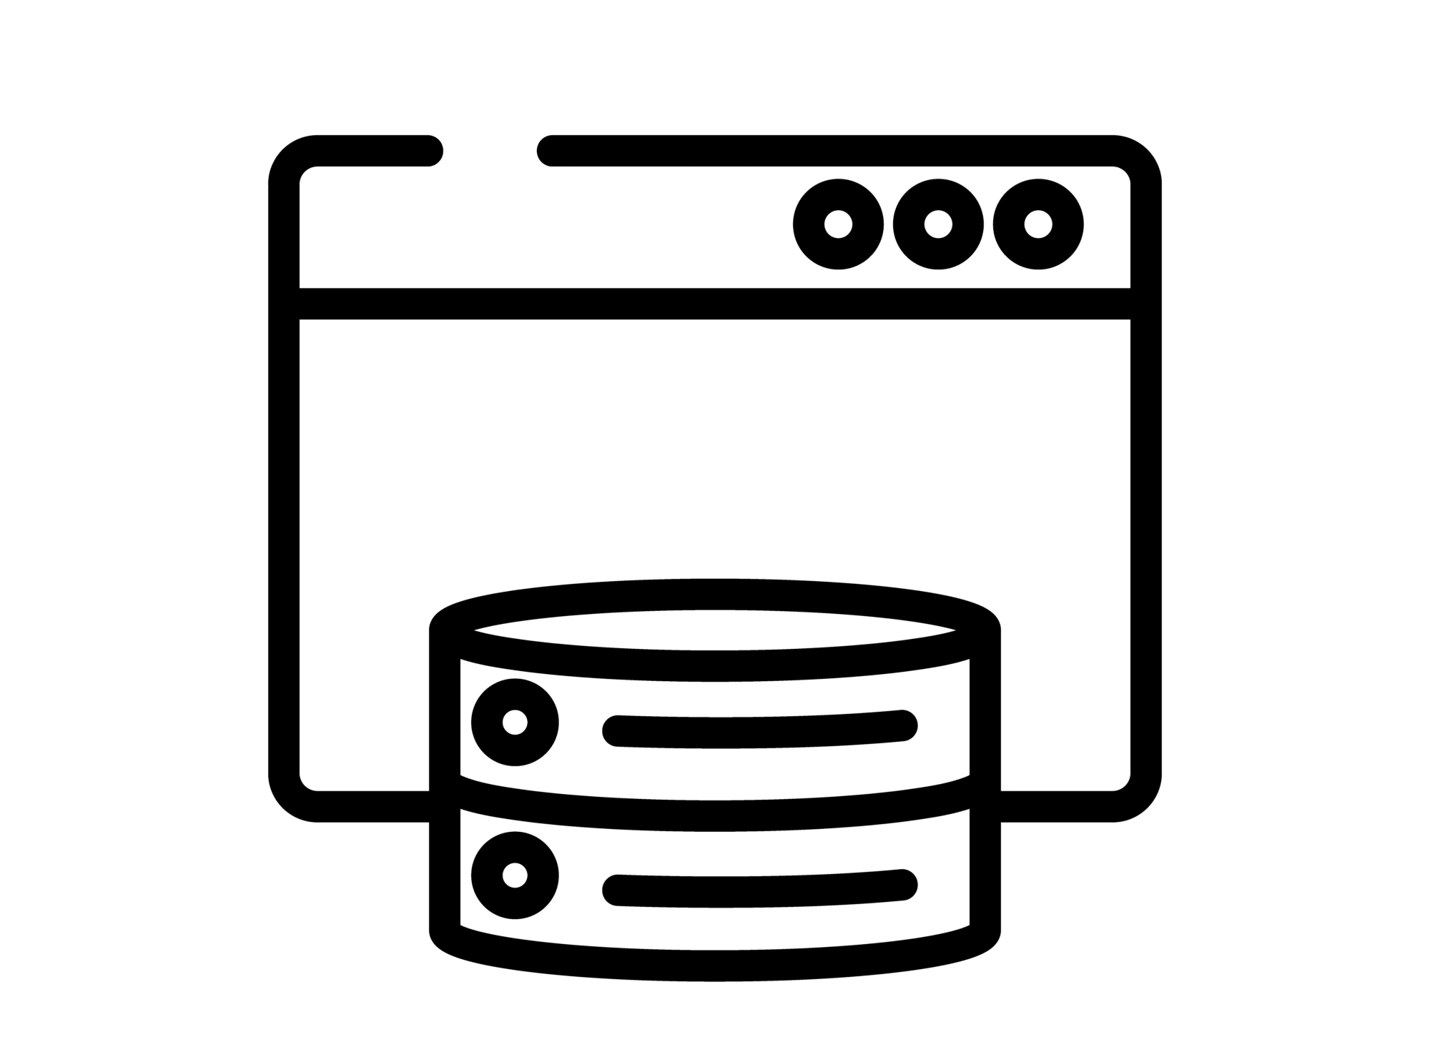
CACHING
Response Caching
In-Memory Caching
Distributed Caching

Slide 28
RESPONSE CACHING
Directs Caching on the consumer side
HTTP 1.1 Caching specification
Install the NuGet package:
Microsoft.Extensions.Caching.Abstractions
At start up add to Services:
services.AddResponseCaching();

Slide 29
RESPONSE CACHING
Attribute on Controller or Action
[ResponseCache(Duration = 60)]
Response Header:
Cache-Control: public,max-age=60
[ResponseCache(Location = ResponseCacheLocation.None, NoStore = true)]
Response Header:
Cache-Control: no-store,no-cache
Pragma: no-cache

Slide 30
IN-MEMORY CACHING
Install the NuGet package:
Microsoft.Extensions.Caching.Abstractions
At start up add to Services:
services.AddMemoryCache();

Slide 31
DISTRIBUTED CACHING
Local Redis Cache
SQL Server Cache
Azure Redis Cache
Amazon ElastiCache
Google Cloud Memcache

Slide 32

http://learn.microsoft.com/en-us/ef/core/
devblogs.microsoft.com/dotnet/tag/entity-framework/
https://www.youtube.com/@dotnet
Entity Framework Core
OTHER
RESOURCES
https://github.com/dotnet/efcore

Slide 33

Questions?
Turbo Charging EF Core

Slide 34

THANK YOU

